Slide 1
Network Attacks
Lecture 17-18 (Theory)
Dr. Dinesh Vij
Department of Computer Science and Engineering,
Chitkara University, Punjab
Computer Networks _22CS008

Slide 2
INDEX
Types of Malwares
Reconnaissance Attacks
Access Attacks
Denial of Service Attacks

Slide 3
Types of Malware
This topic discusses about how threat actors gain access to network or restrict authorized users from having access.
Malware is short for malicious software. It is code or software specifically designed to damage, disrupt, steal, or inflict “bad” or illegitimate action on data, hosts, or networks.
Viruses, worms, and Trojan horses are types of malware.

Slide 4
Viruses
A computer virus is a type of malware that propagates by inserting a copy of itself into, and becoming part of, another program.
It spreads from one computer to another, leaving infections as it travels.
Viruses can range in severity from causing mildly annoying effects, to damaging data or software and causing denial of service (DoS) conditions.
Almost all viruses are attached to an executable file, which means the virus may exist on a system but will not be active or able to spread until a user runs or opens the malicious host file or program.

Slide 5
Viruses
When the host code is executed, the viral code is executed as well. Normally, the host program keeps functioning after the virus infects it.
However, some viruses overwrite other programs with copies of themselves, which destroys the host program altogether.
Viruses spread when the software or document they are attached to is transferred from one computer to another using the network, a disk, file sharing, or infected email attachments.

Slide 6
Worms
Computer worms are similar to viruses in that they replicate functional copies of themselves and can cause the same type of damage.
In contrast to viruses, which require the spreading of an infected host file, worms are standalone software and do not require a host program or human help to propagate.
A worm does not need to attach to a program to infect a host and enter a computer through a vulnerability in the system.
Worms take advantage of system features to travel through the network unaided.

Slide 7
Trojan Horses
A Trojan horse is another type of malware named after the wooden horse the Greeks used to infiltrate Troy. It is a harmful piece of software that looks legitimate.
Users are typically tricked into loading and executing it on their systems. After it is activated, it can achieve any number of attacks on the host, from irritating the user (with excessive pop-up windows or changing the desktop) to damaging the host (deleting files, stealing data, or activating and spreading other malware, such as viruses).
Trojan horses are also known to create back doors to give malicious users access to the system.
Unlike viruses and worms, Trojan horses do not reproduce by infecting other files. Trojan horses must spread through user interaction such as opening an email attachment or downloading and running a file from the internet.

Slide 8
Network Attacks
In addition to malicious code attacks, it is also possible for networks to fall prey to various network attacks. Network attacks can be classified into three major categories:
Reconnaissance attacks - The discovery and mapping of systems, services, or vulnerabilities.
Access attacks - The unauthorized manipulation of data, system access, or user privileges.
Denial of service - The disabling or corruption of networks, systems, or services.

Slide 9
Reconnaissance Attacks
For reconnaissance attacks, external threat actors can use internet tools, such as the nslookup and whois utilities, to easily determine the IP address space assigned to a given corporation or entity.
After the IP address space is determined, a threat actor can then ping the publicly available IP addresses to identify the addresses that are active.
To help automate this step, a threat actor may use a ping sweep tool, such as fping or gping.
This systematically pings all network addresses in a given range or subnet.
This is similar to going through a section of a telephone book and calling each number to see who answers.

Slide 10
Types of Reconnaissance Attacks
Internet Queries:
The threat actor is looking for initial information about a target.
Various tools can be used, including Google search, the websites of organizations, whois, and more.
Ping Sweeps:
The threat actor initiates a ping sweep to determine which IP addresses are active.
Port Scans:
The threat actor performing a port scan on the discovered active IP addresses.

Slide 11
Access Attacks
Access attacks exploit known vulnerabilities in authentication services, FTP services, and web services to gain entry to web accounts, confidential databases, and other sensitive information.
An access attack allows individuals to gain unauthorized access to information that they have no right to view.
Access attacks can be classified into four types:
password attacks,
trust exploitation,
port redirection,
man-in-the middle.

Slide 12
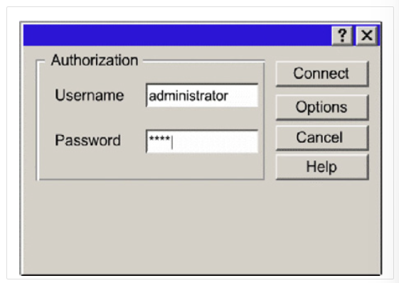
Password Attacks
Threat actors can implement password attacks using several different methods:
Brute-force attacks
Trojan horse attacks
Packet sniffers
Fig. 1 Password Attacks

Slide 13
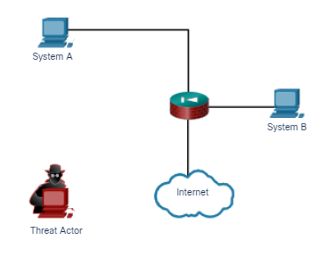
Trust Exploitation
In a trust exploitation attack, a threat actor uses unauthorized privileges to gain access to a system, possibly compromising the target. Click Play in the figure to view an example of trust exploitation.
In the figure, System A trusts System B. System B trusts everyone. The threat actor wants to gain access to System A. Therefore, the threat actor compromises System B first and then can use System B to attack System A.
Fig. 2 Trust Exploitation

Slide 14
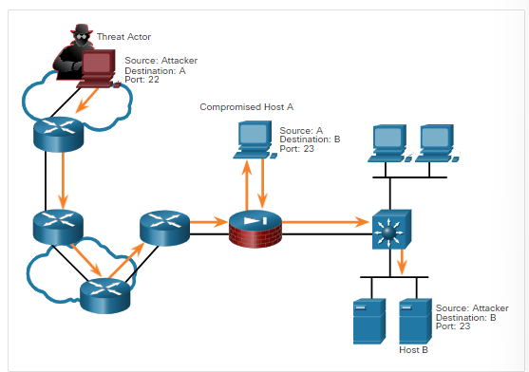
Port Redirection
In a port redirection attack, a threat actor uses a compromised system as a base for attacks against other targets.
The example in the figure shows a threat actor using SSH (port 22) to connect to a compromised host A. Host A is trusted by host B and, therefore, the threat actor can use Telnet (port 23) to access it.
Fig. 3 Port Redirection

Slide 15
Man-in-the-Middle
In a man-in-the-middle attack, the threat actor is positioned in between two legitimate entities in order to read or modify the data that passes between the two parties.
The figure on the next slide displays an example of a man-in-the-middle attack.

Slide 16
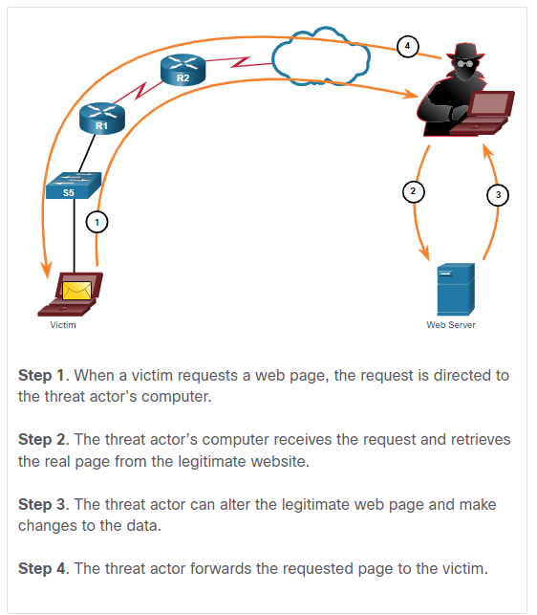
Man-in-the-Middle
Fig. 4 Man-in-the-middle

Slide 17
Denial of Service Attacks
Denial of service (DoS) attacks are the most publicized form of attack and among the most difficult to eliminate.
However, because of their ease of implementation and potentially significant damage, DoS attacks deserve special attention from security administrators.
DoS attacks take many forms. Ultimately, they prevent authorized people from using a service by consuming system resources.
To help prevent DoS attacks it is important to stay up to date with the latest security updates for operating systems and applications.

Slide 18
DoS Attack
DoS attacks are a major risk because they interrupt communication and cause significant loss of time and money.
These attacks are relatively simple to conduct, even by an unskilled threat actor.

Slide 19
DDoS Attack
A DDoS is similar to a DoS attack, but it originates from multiple, coordinated sources.
For example, a threat actor builds a network of infected hosts, known as zombies. A network of zombies is called a botnet.
The threat actor uses a command and control (CnC) program to instruct the botnet of zombies to carry out a DDoS attack.

Slide 20
Q & A
1) Angela, an IT staff member at ACME Inc., notices that communication with the company’s web server is very slow. After investigating, she determines that the cause of the slow response is a computer on the internet sending a very large number of malformed web requests to ACME’S web server. What type of attack is described in this scenario?
Access attack
Denial of service (DoS) attack
Malware attack
Reconnaissance attack
Answer: (b)

Slide 21
Q & A
2) George needed to share a video with a co-worker. Because of the large size of the video file, he decided to run a simple FTP server on his workstation to serve the video file to his co-worker. To make things easier, George created an account with the simple password of “file” and provided it to his co-worker on Friday. Without the proper security measures or a strong password, the IT staff was not surprised to learn on Monday that George’s workstation had been compromised and was trying to upload work related documents to the internet. What type of attack is described in this scenario?
Access attack
Denial of service (DoS) attack
Malware attack
Reconnaissance attack
Answer: (a)

Slide 22
Q & A
3) Jeremiah was browsing the internet from his personal computer when a random website offered a free program to clean his system. After the executable was downloaded and running, the operating system crashed. Crucial operating system related files had been corrupted and Jeremiah’s computer required a full disk format and operating system re-installation. What type of attack is described in this scenario?
Access attack
Denial of service (DoS) attack
Malware attack
Reconnaissance attack
Answer: (c)

Slide 23
Q & A
4) Arianna found a flash drive lying on the pavement of a mall parking lot. She asked around but could not find the owner. She decided to keep it and plugged it into her laptop, only to find a photo folder. Feeling curious, Arianna opened a few photos before formatting the flash drive for her own use. Afterwards, Arianna noticed that her laptop camera was active. What type of attack is described in this scenario?
Access attack
Denial of service (DoS) attack
Malware attack
Reconnaissance attack
Answer: (c)

Slide 24
Q & A
5) A computer is used as a print server for ACME Inc. The IT staff failed to apply security updates to this computer for over 60 days. Now the print server is operating slowly, and sending a high number of malicious packets to its NIC. What type of attack is described in this scenario?
Access attack
Denial of service (DoS) attack
Malware attack
Reconnaissance attack
Answer: (b)

Slide 25
Q & A
6) Sharon, an IT intern at ACME Inc., noticed some strange packets while revising the security logs generated by the firewall. A handful of IP addresses on the internet were sending malformed packets to several different IP addresses, at several different random port numbers inside ACME Inc. What type of attack is described in this scenario?
Access attack
Denial of service (DoS) attack
Malware attack
Reconnaissance attack
Answer: (d)

Slide 26
References
https://lms.netacad.com/course/view.php?id=2260561
https://contenthub.netacad.com/itn-dl/16.2.1

